Slide 2
Presentation Outline
Introduction
Background | Problem Statement | Objectives | Expected outcomes | Justification
Literature review.
Existing technologies | Related works | Gap Analysis
Methodology
Designs process | Simulations | Final Designs.
Results
Final Assembly | Budget
Conclusion
Notes:
10/13/2020
2

Slide 3
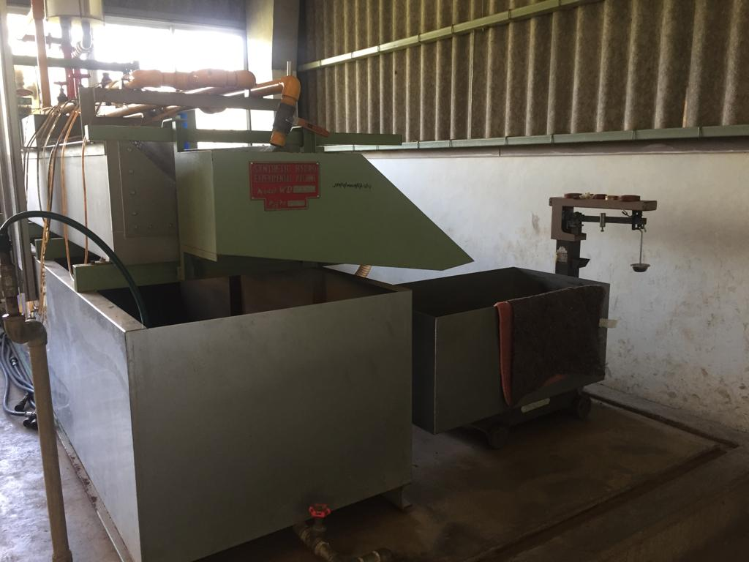
Introduction: Background & problem statement
Background
Fluid flow measurement
- Quantifying a property of an uninterrupted flow.
Flow meters
- Turbine flow meter, rotameter, venturi, and orifice.
- Bernoulli’s Theorem.
Synthetic Hydro-Experimental Machine
- Consists of venturi, and orifice
- Establishing a relationship between discharge, differential pressure, and the coefficient of discharge.
Problem Statement
Fluid flow experiments require one to synchronize discharge collection with time and temperature measurement.
Current state of the Synthetic Hydro-Experimental Machine.
Determination of steps based on human intuition
Discharge collection synchronization by a minimum of two operators
Incremental weight measurement.
Results outside the tolerable range.
Automated Synthetic Hydro-Experimental Machine
Precise discharge flow control.
Automated discharge collection.
Automate discharge weight and temperature measurement.

Slide 4
Introduction: Objectives
Main Objective
To automate the discharge collection process of the Synthetic Hydro-Experimental Machine.
Specific Objectives
To design an automated discharge flow control unit that can turn the ball valve in steps of less than 1⁰ and divert the flow in less than 1 second.
2. To design and fabricate a discharge handling unit with automated weight, time, and temperature measurements, and a discharge collection tank that can discharge in the shortest time possible.
3. To design a graphical user interface and a robust control algorithm to integrate the units

Slide 5
Literature review
Existing Technologies
- Computational fluid dynamics
- ANSYS, SolidWorks, Autodesk CFD,…
- Analytical predictions
- Pure mathematics with Bernoulli’s Equation.
Related Works
- Electromagnetic Actuation
- Automated Water Sampler (A. Odetti, 2019)
- Pneumatic Control
- Cartridge-type pneumatic dispenser(S. Lee, 2009)
Gaps
- Credibility of the experiment.
- Resources
- Error margins

Slide 6
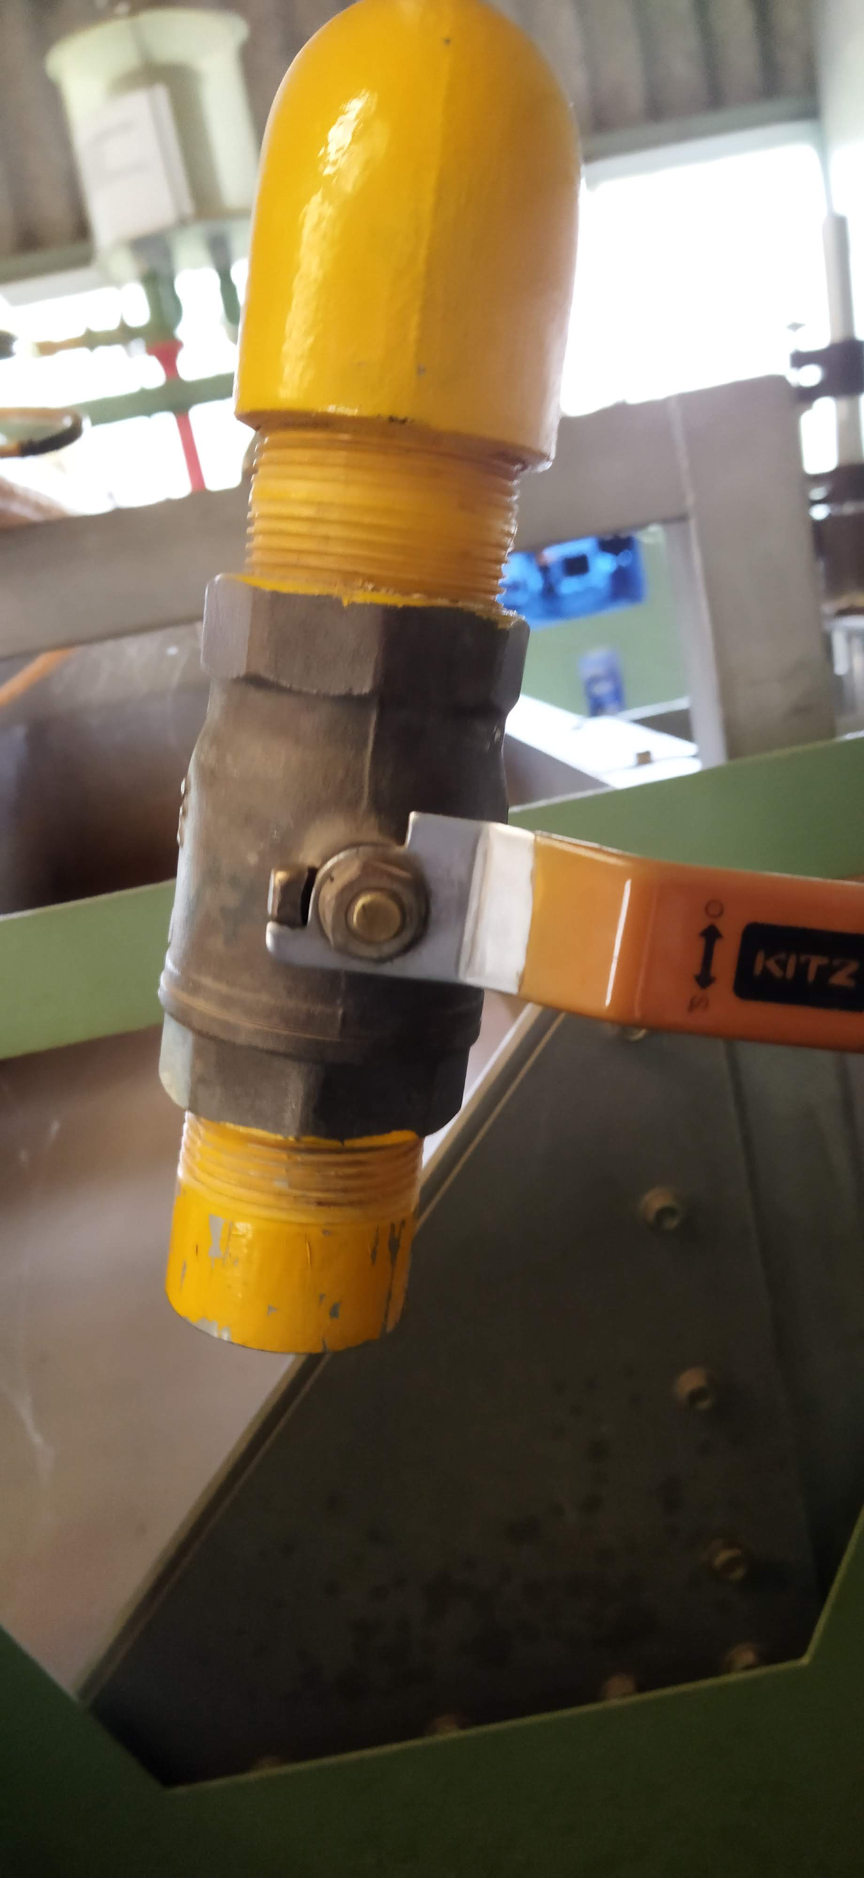
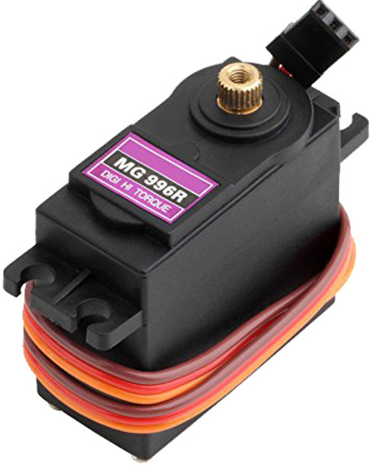
Methodology: Discharge flow control
Flow Control
Requirements: - Utilize the existing ball valve
- Step sizes
- Torque requirement
Selected: MG996R Servo Motor
Justification
Smaller angles less than 1⁰
can be achieved by writing smaller pulse widths.
Considerations
Stepper Motors
Micro-step driver.
Typically 1.8⁰ and sometimes 0.9⁰
Low-speed application < 1500rpm
Servo Motors
Optional driver
Smaller angles, typically 1⁰
High-speed application > 1500rpm
Holding the servo motor in place
Considerations
Shape of the motor.
Motor position when powered.
Requirements
Motor’s zero position when powered = Ball valve’s closed position.
Manual re-alignment.

Slide 7
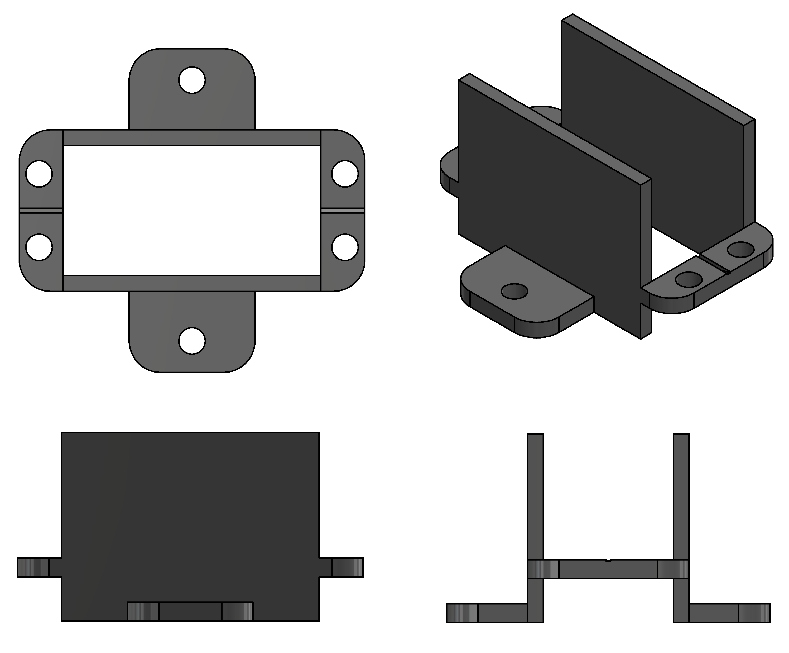
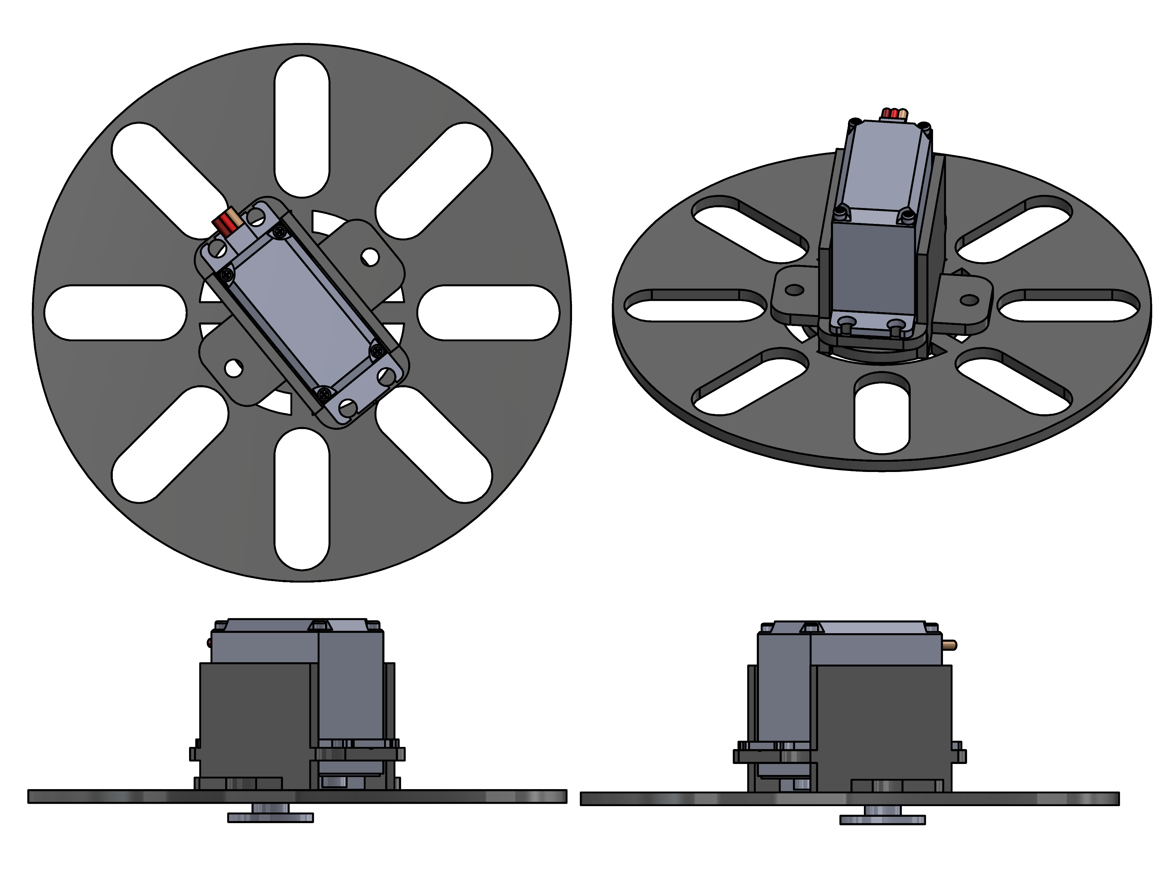
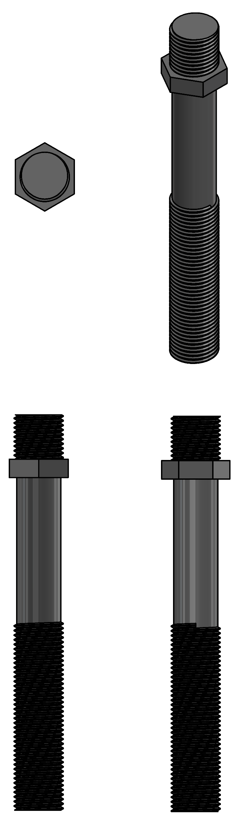
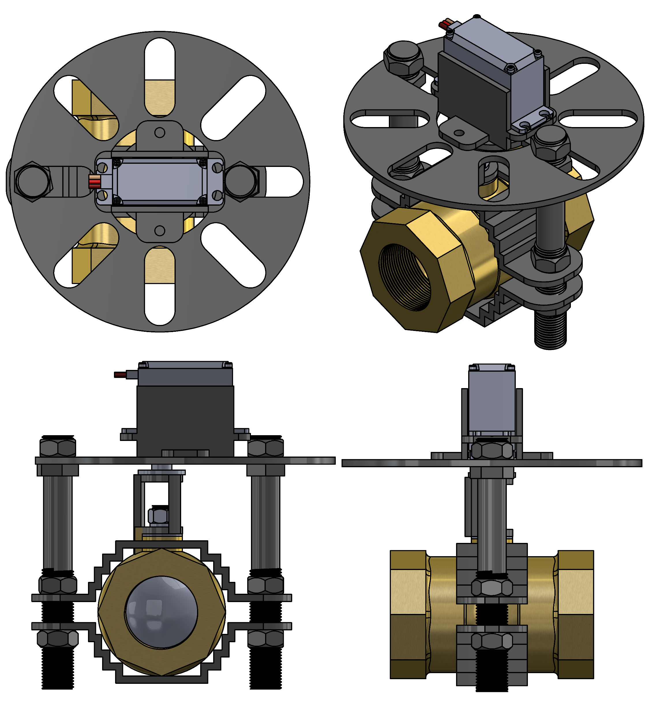
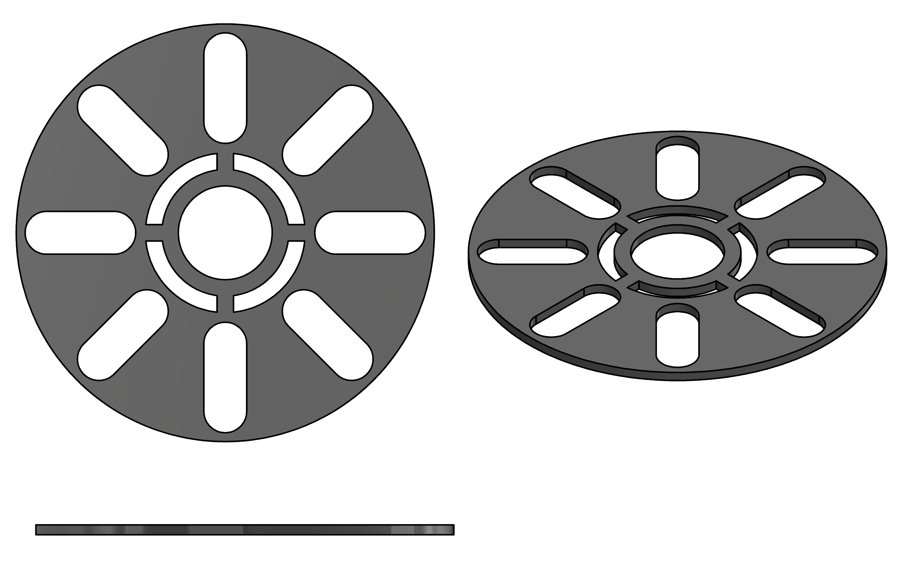
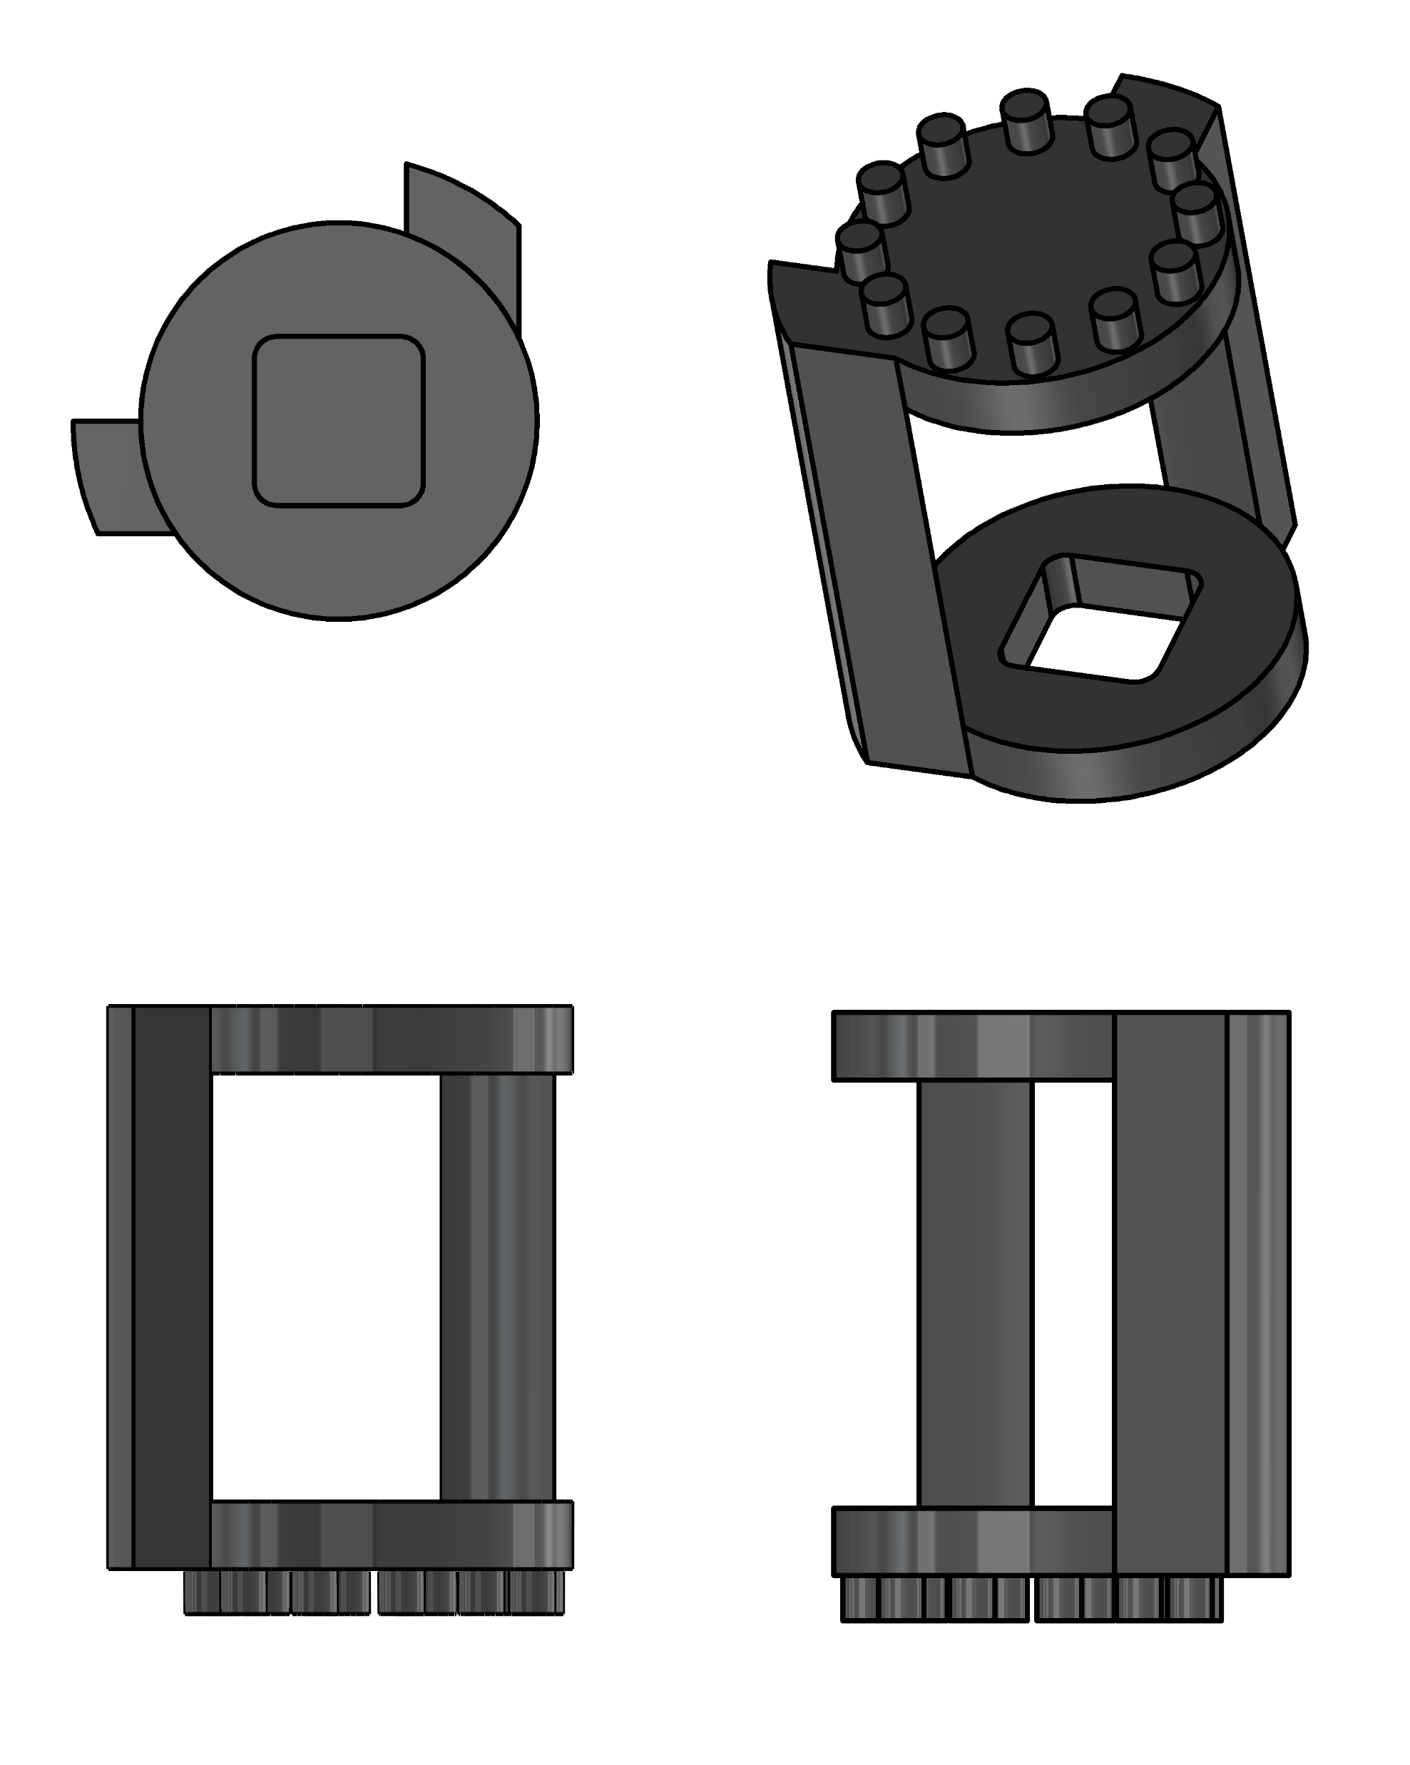
Methodology: Discharge flow control
1
3
5
6
2
4

Slide 8
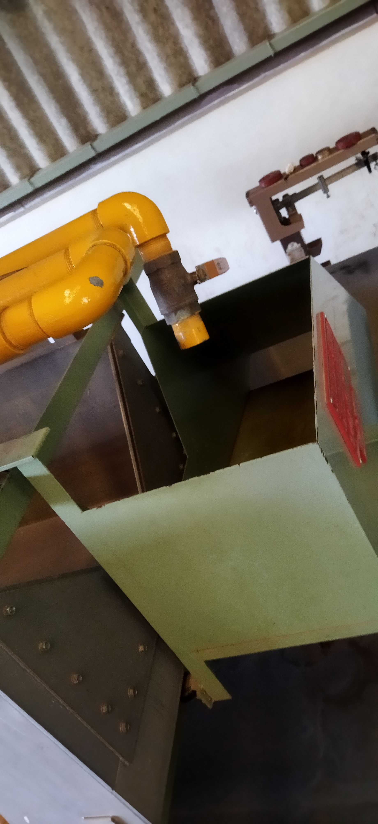
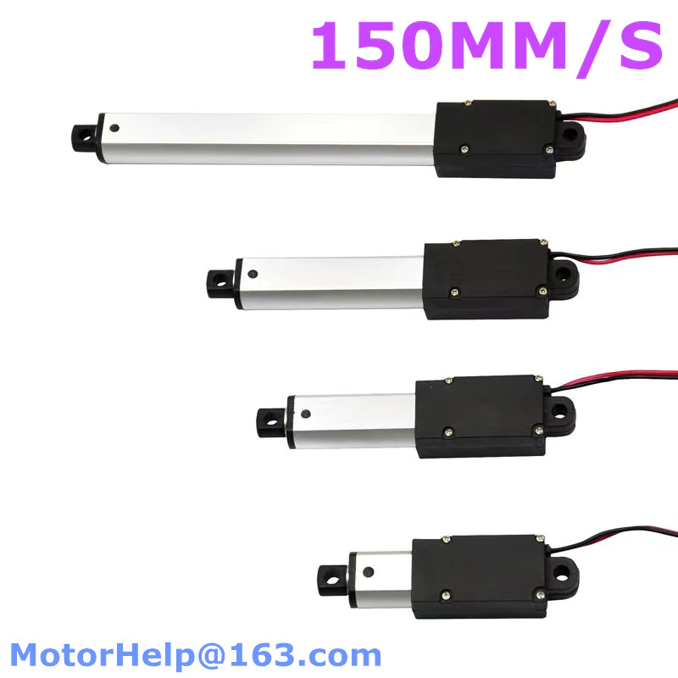
Methodology: Discharge Flow control
Flow Diversion
Requirements: - Response time.
- Force requirement.
Selected: P16-S Linear Actuator
Justification
Direct linear push and pull motion
Kinematic mechanism to amplify the displacement.
Holding P16-S in place
Considerations
Shape of the actuator
Vibrations due to stroke.
Requirements
Flexible coupling with the diversion flap.
Support for the weight of the flap and flowing stream.
Considerations
Electromagnetic Actuator
Linear push and pull.
Strength in a stroke = 5N/10mm
Servo motor
Bidirectional rotary motion.
Variable torque

Slide 9
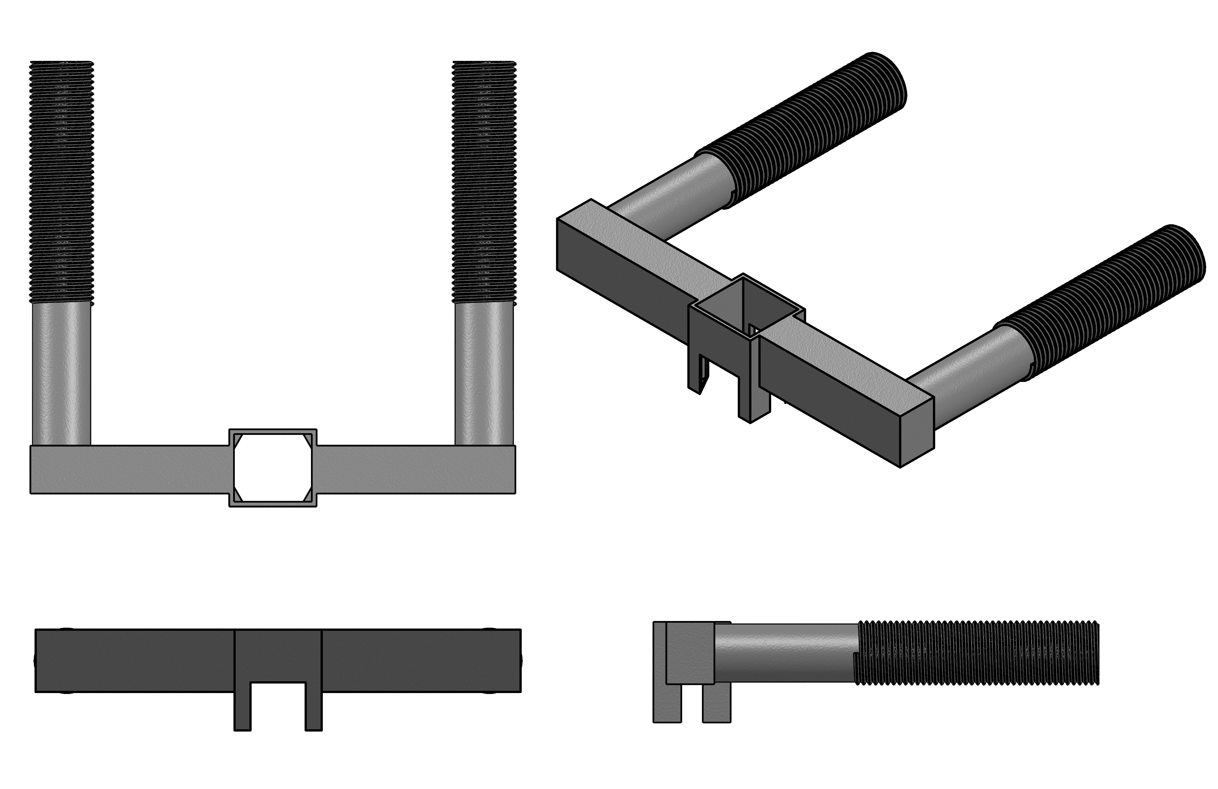
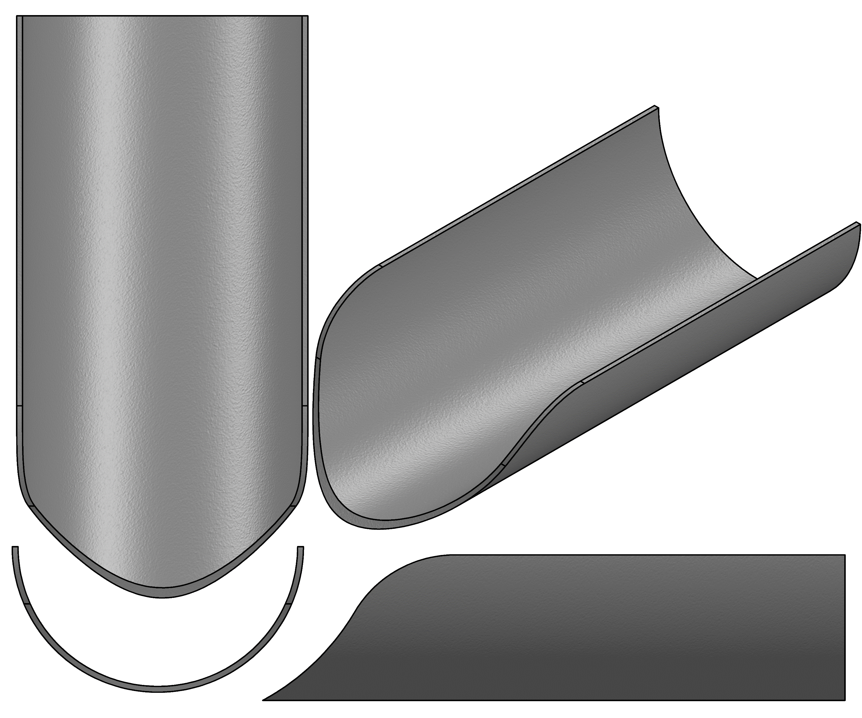
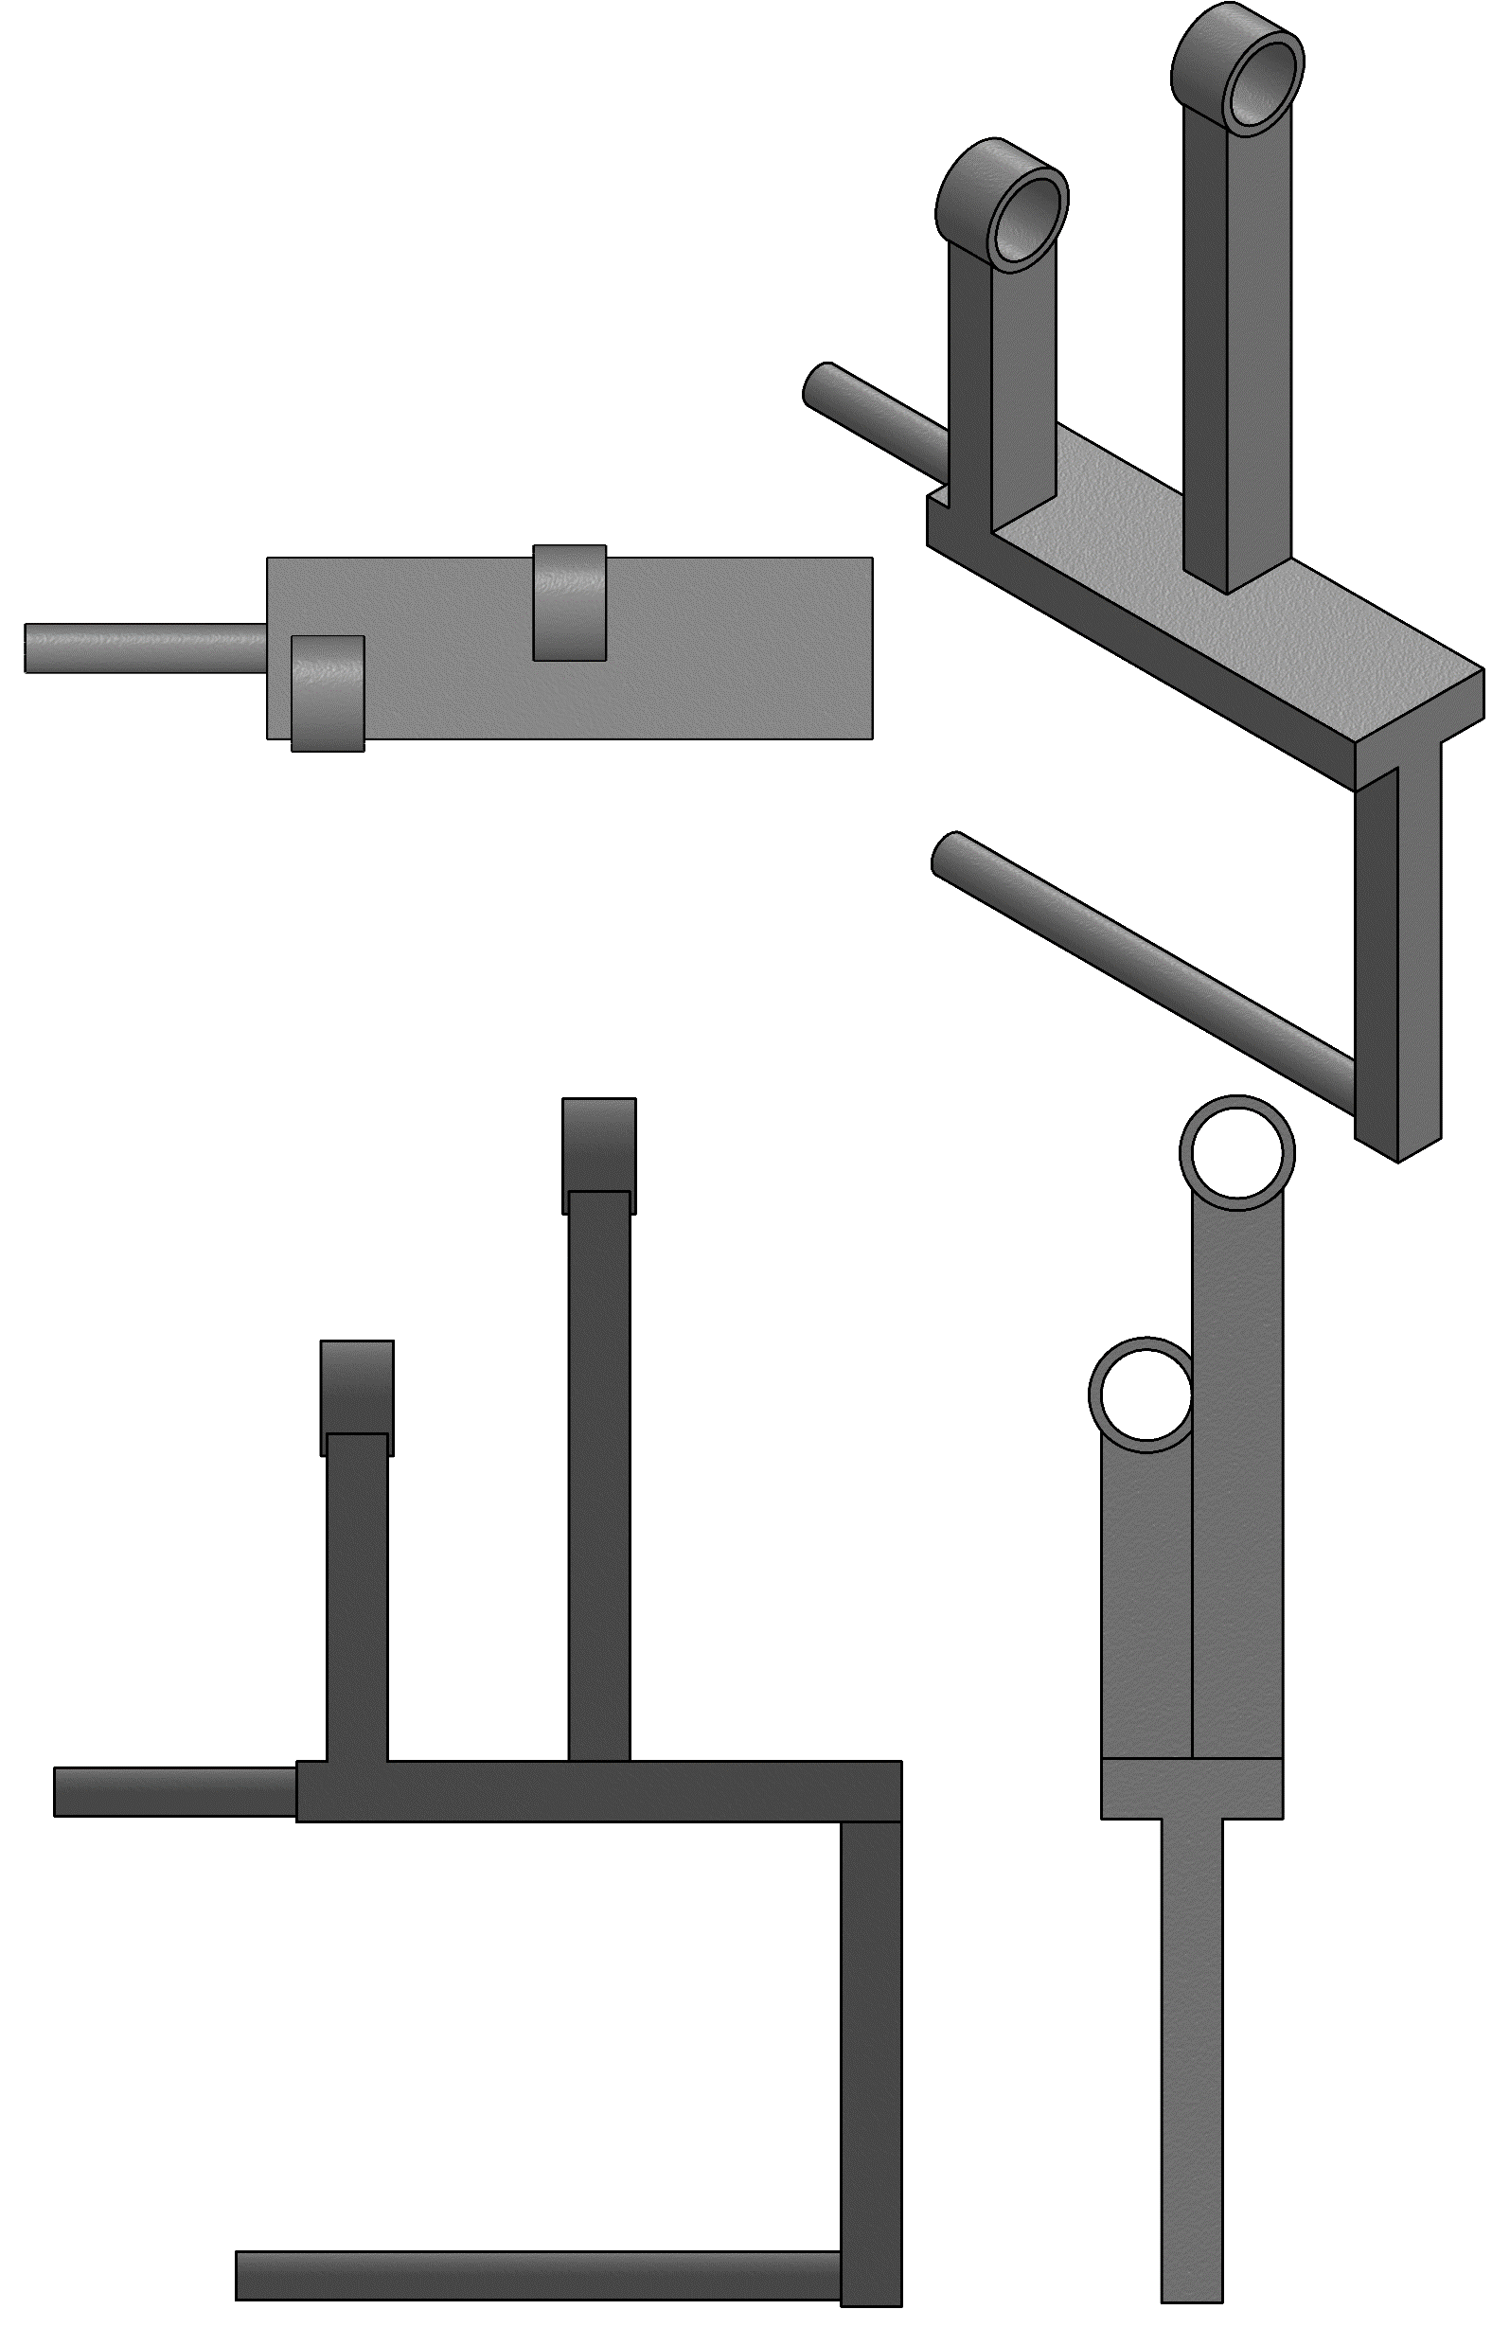
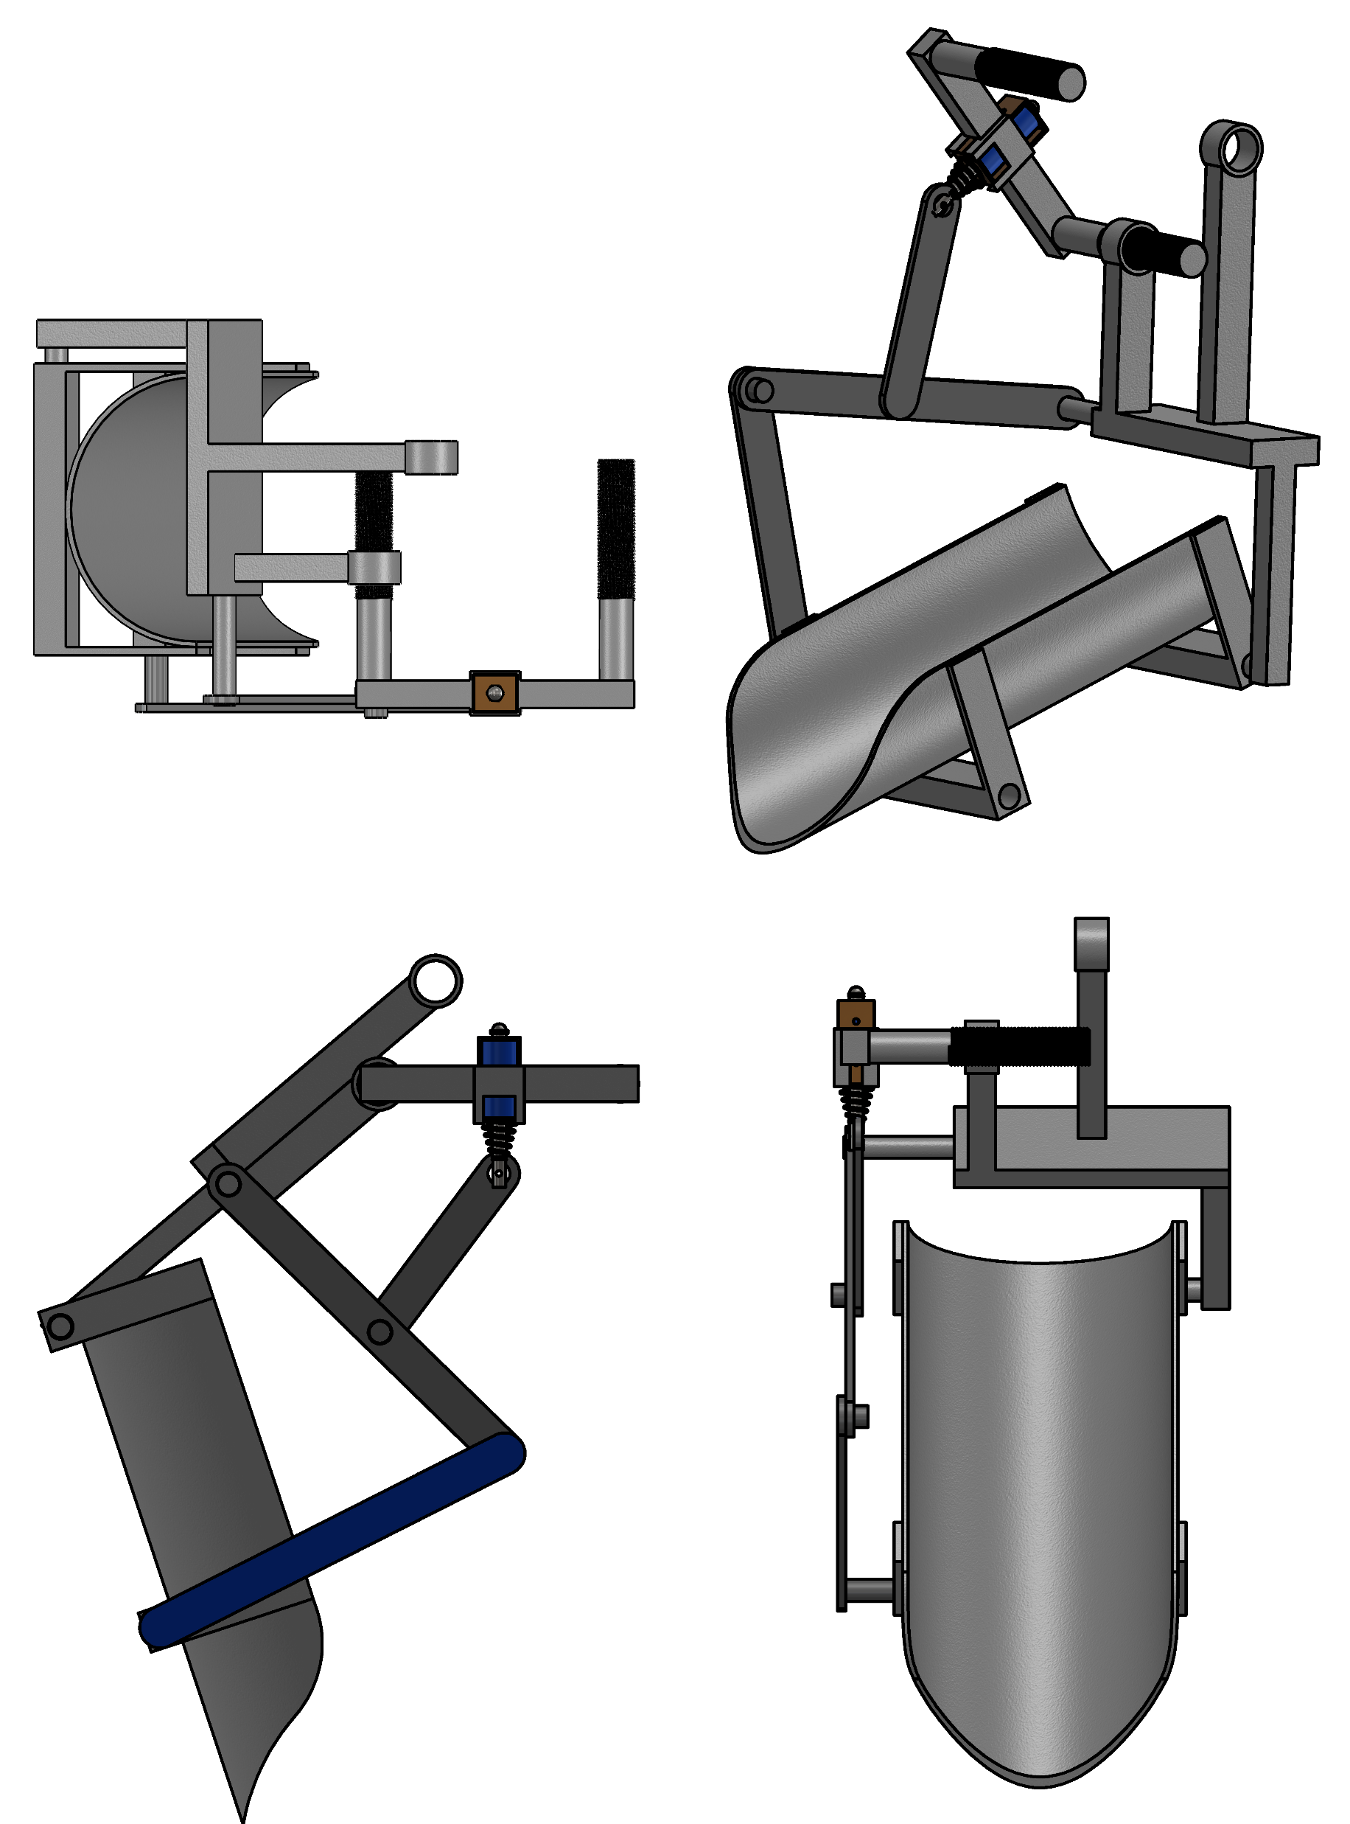
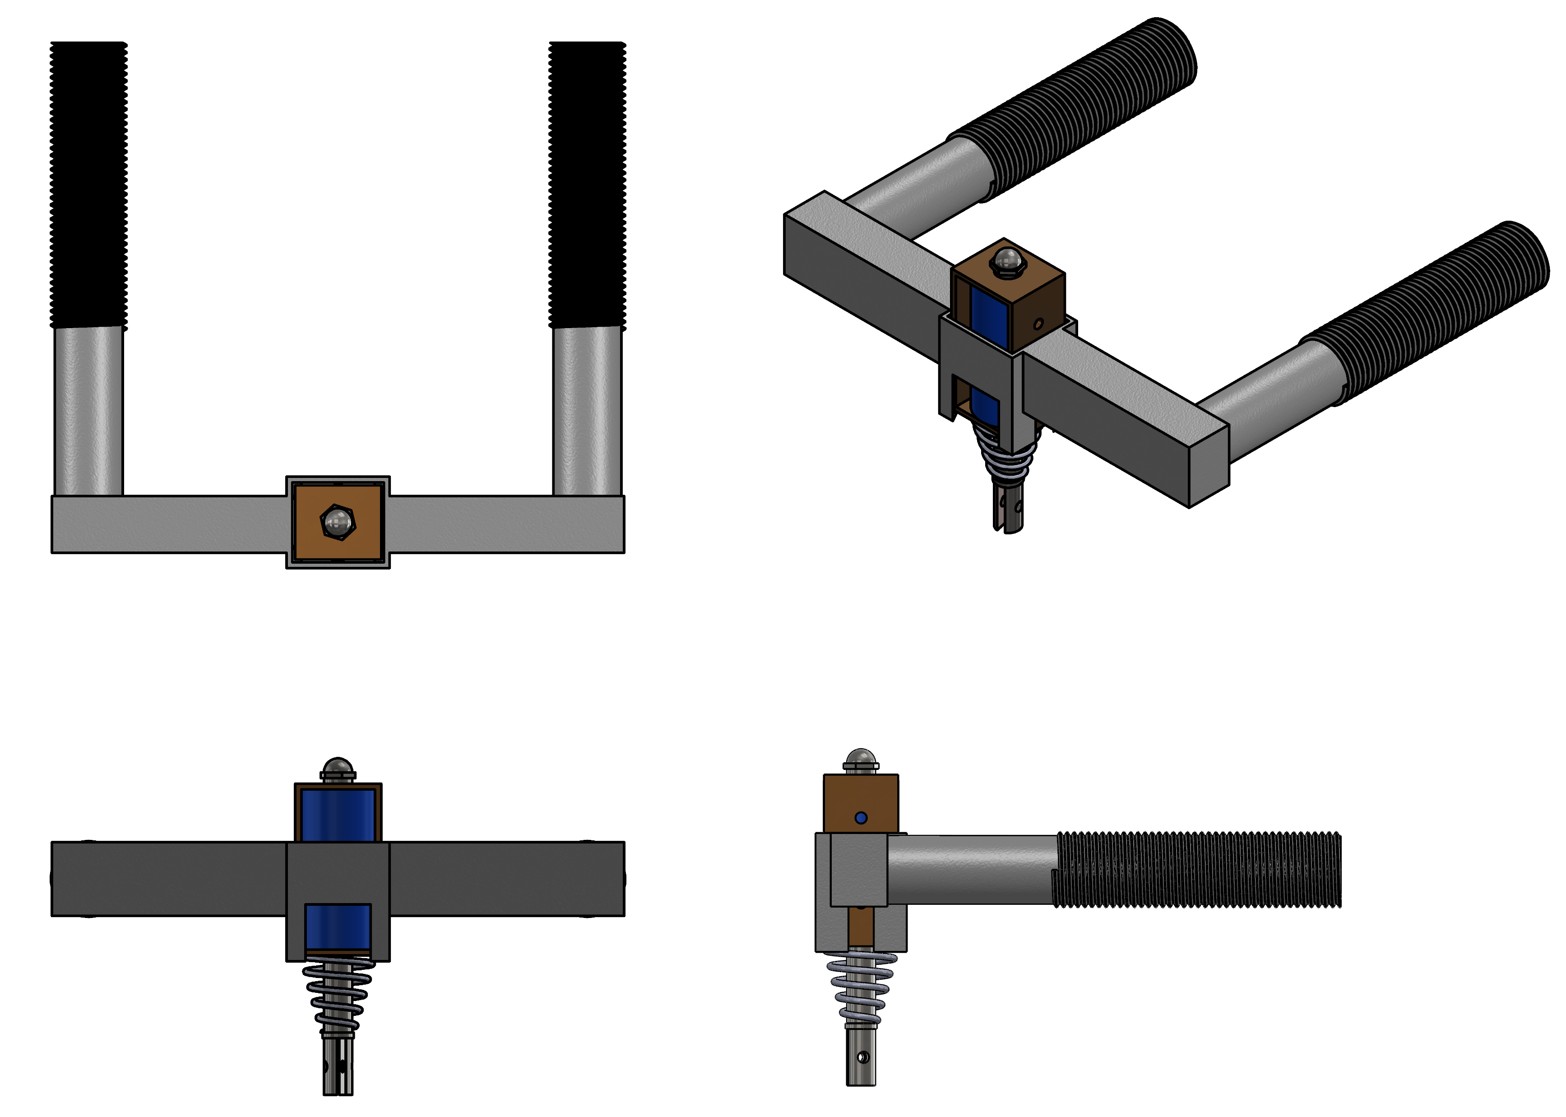
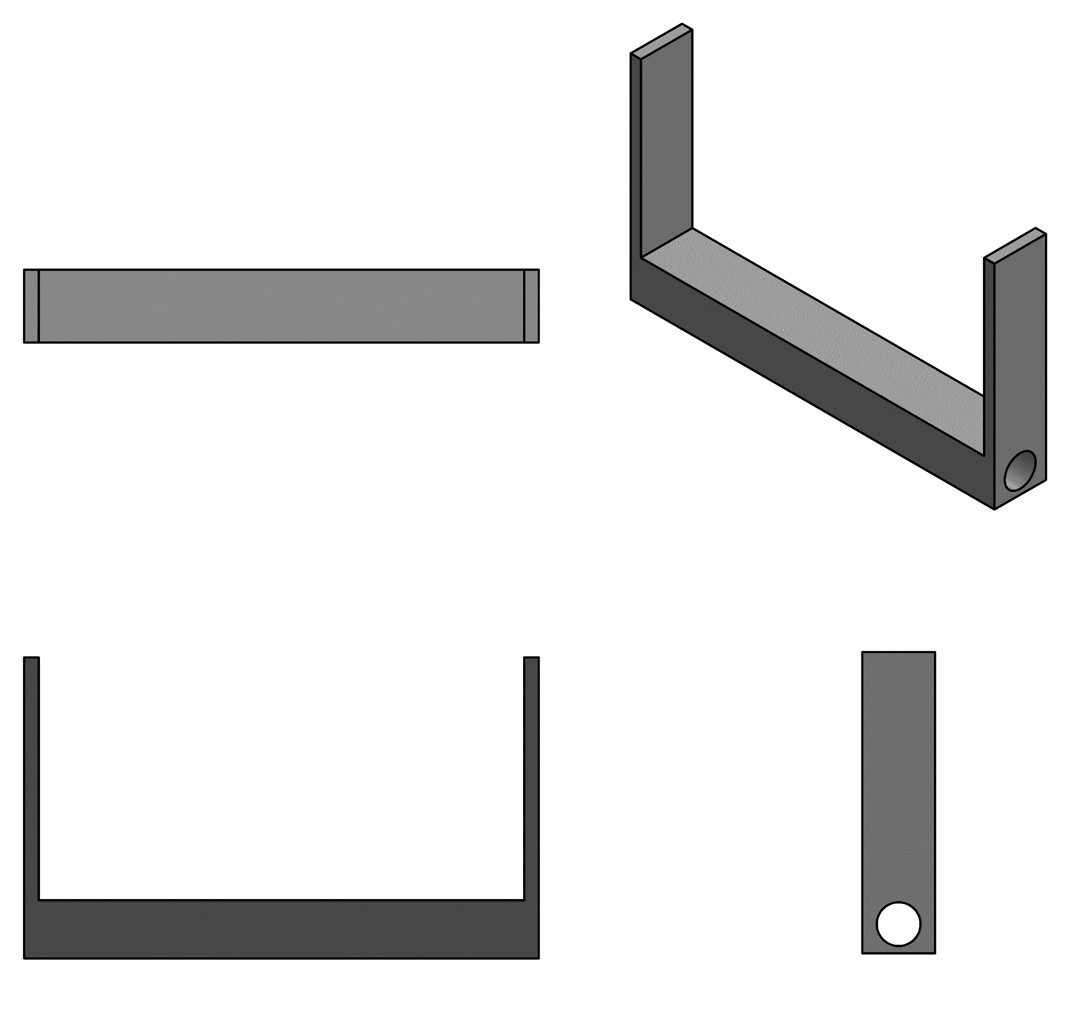
Methodology: Discharge flow control
1
3
5
6
2
4

Slide 10
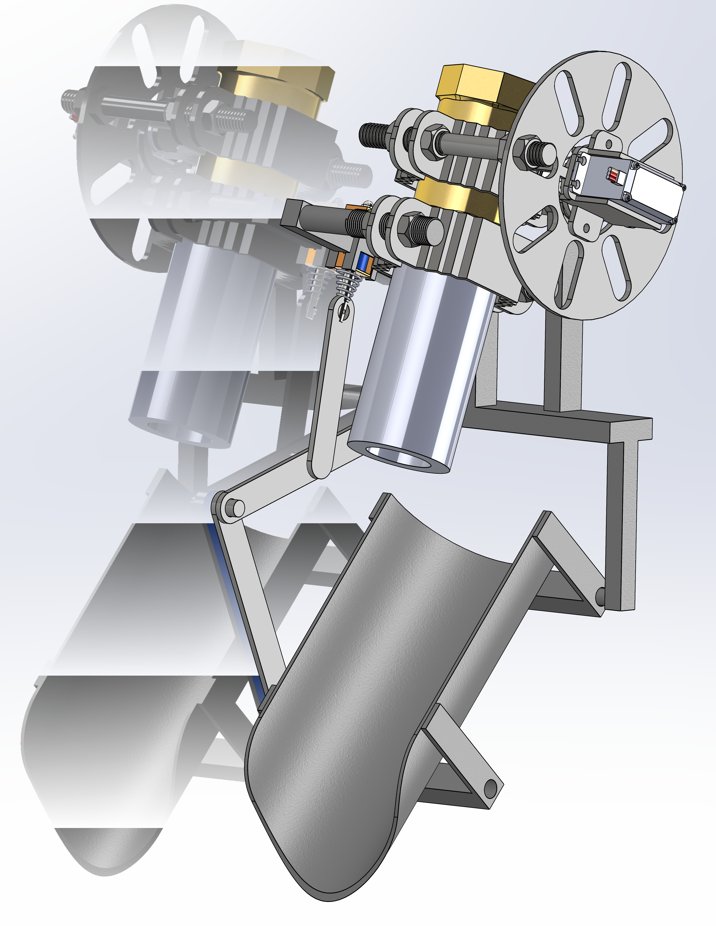
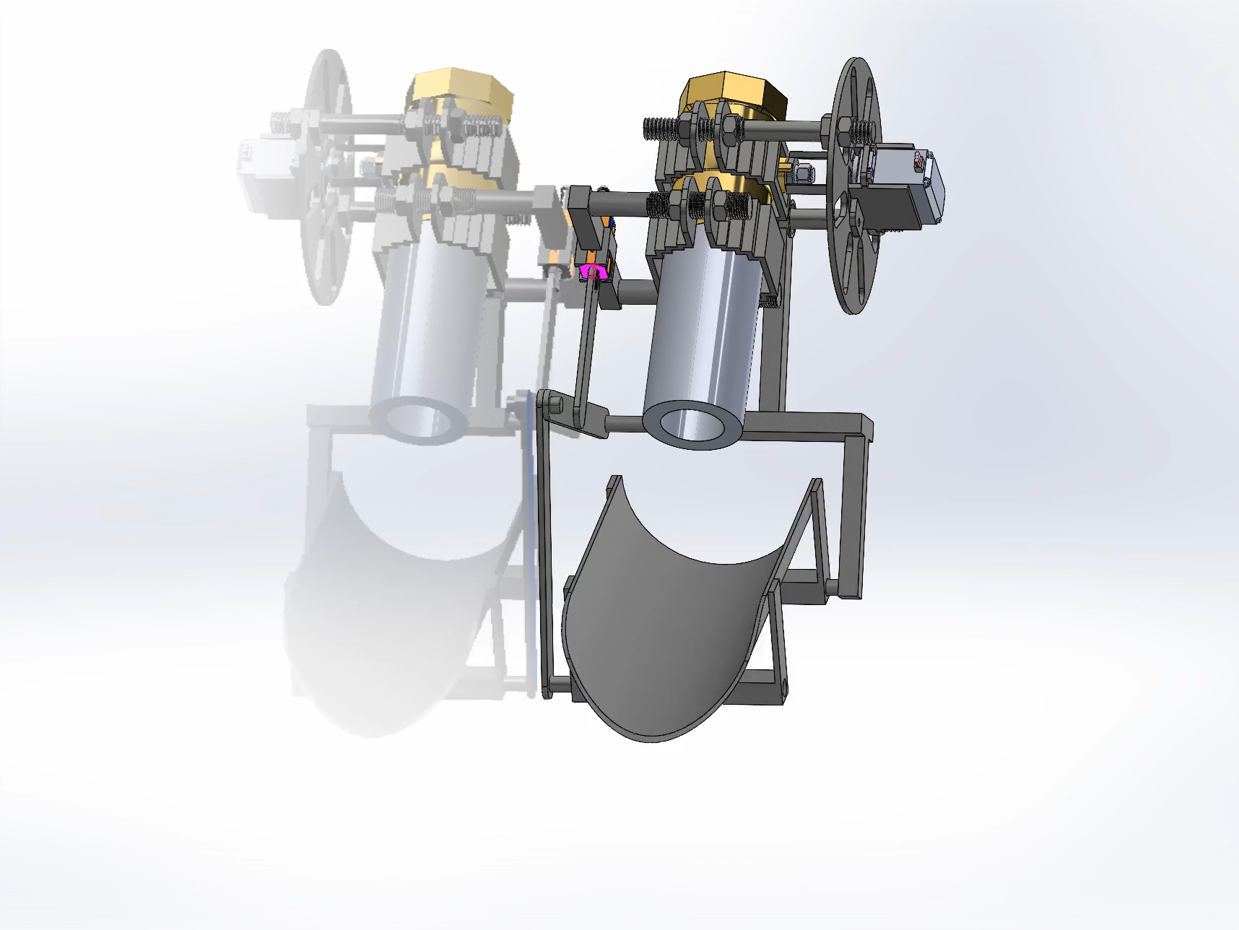
Methodology: Discharge Flow control Unit

Slide 11
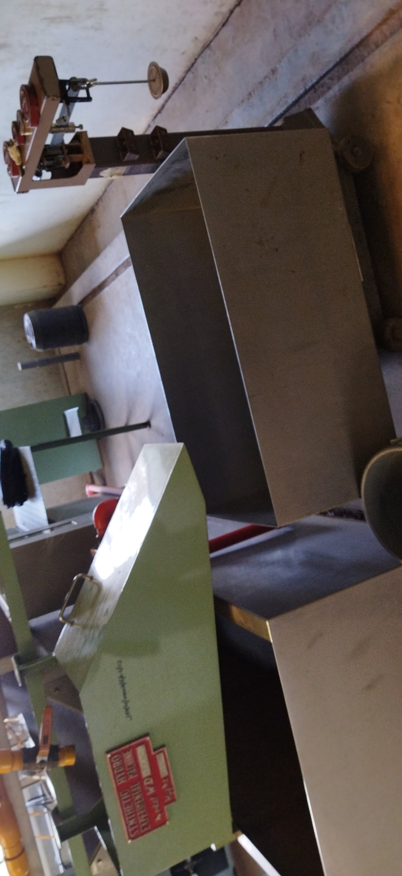
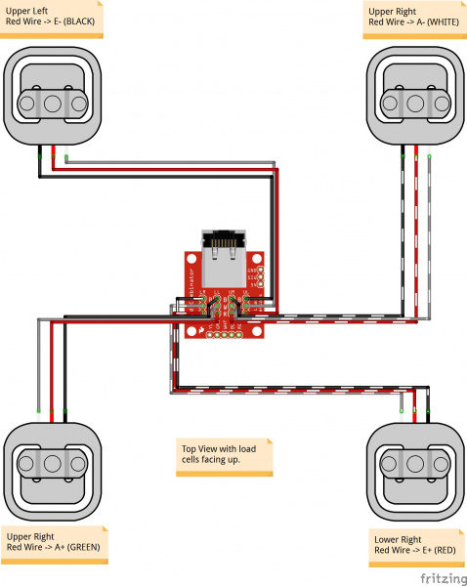


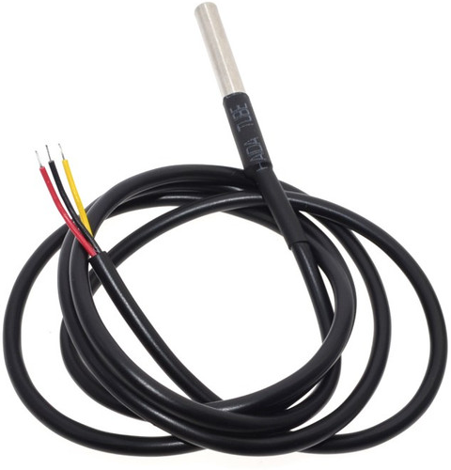
Methodology: Discharge Handling
Discharge weight measurement
Requirements:
Highest possible Sensitivity
Resolution(0-50Kg)
Credibility(forums, and experience)
Selected: Horizontal Cylindrical tank.
Justification
Motivated discharge
Easier to fabricate
1. Discharge collection tank.
Requirements: - Motivated discharge
- Capacity of not less than 20 Liters.
Selected:
50Kg strain-type load cells
Considerations
Discharge temperature measurement.
Requirements:
Highest possible Sensitivity
Resolution(0-40)
Selected: DS18B20 waterproof temperature

Slide 12
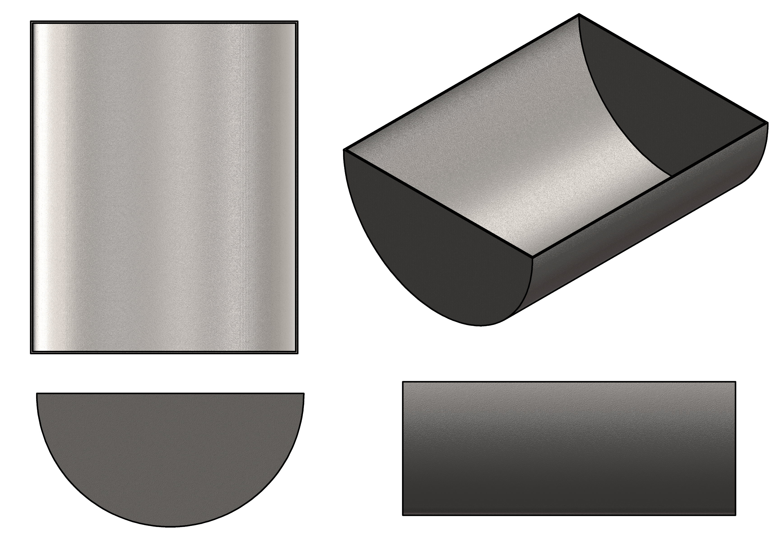
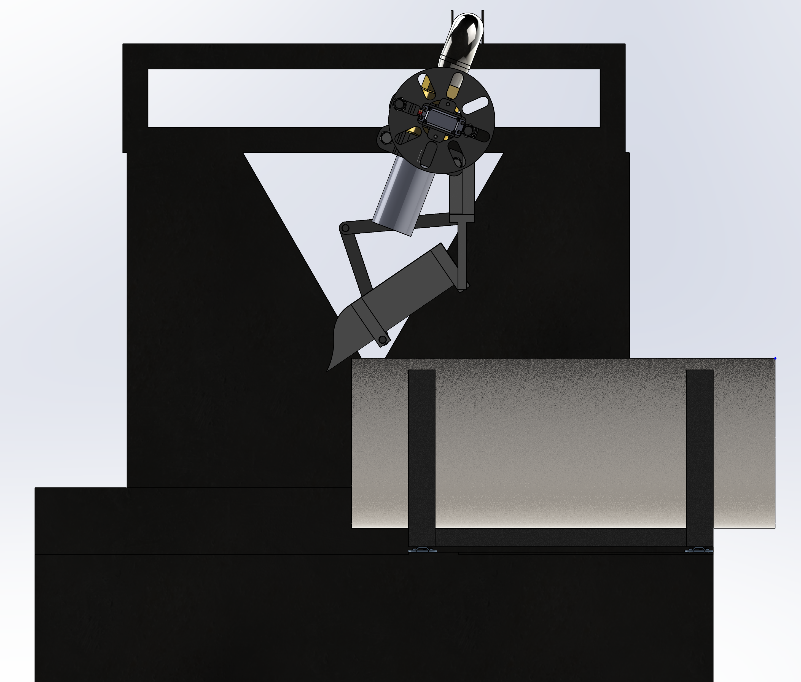
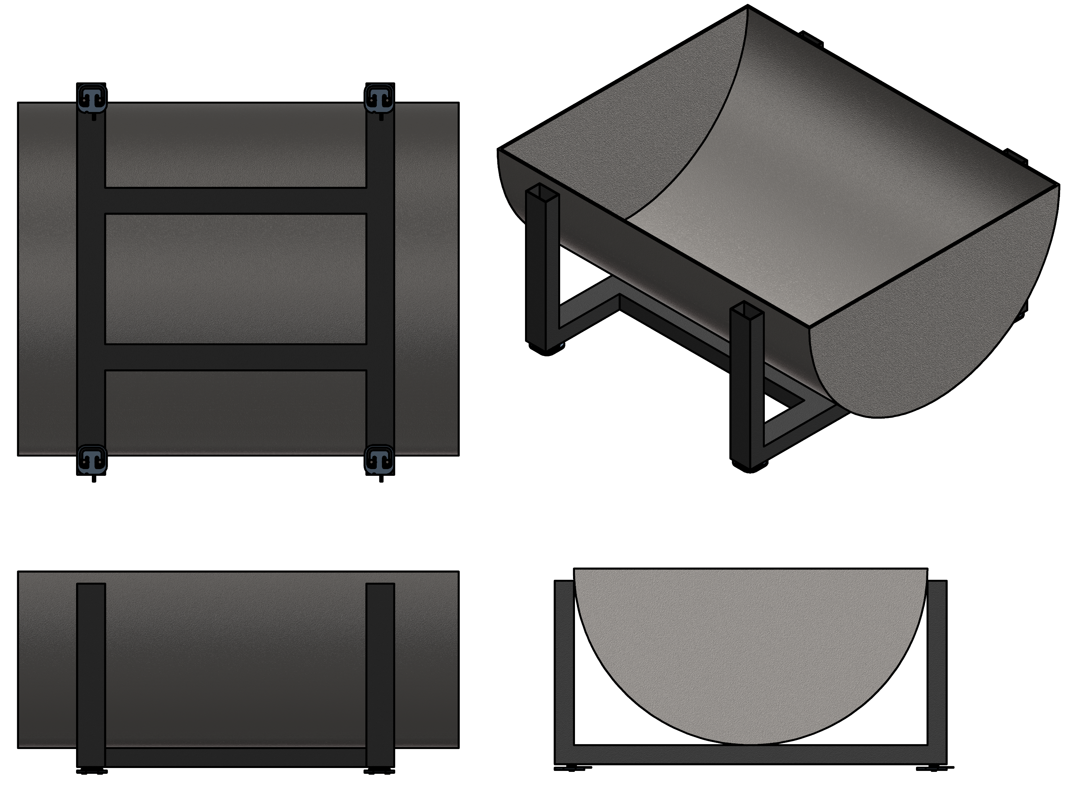
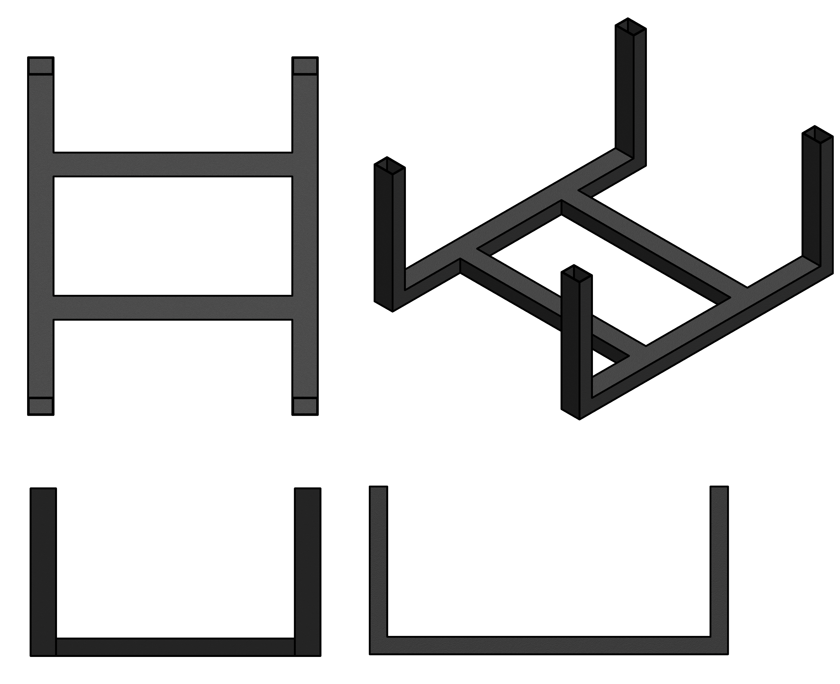
Methodology: Discharge Handling
1
3
4
2

Slide 13
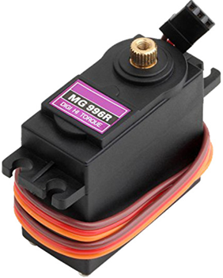
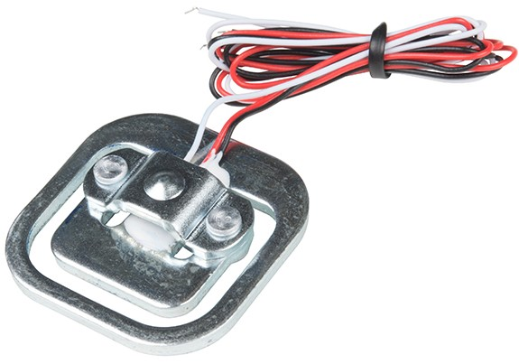
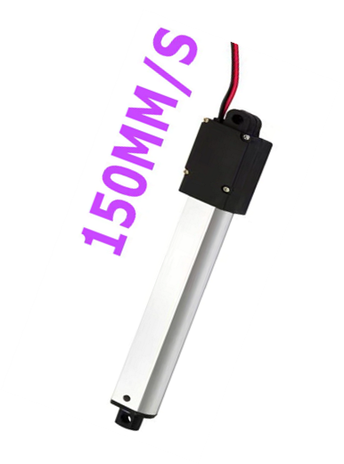
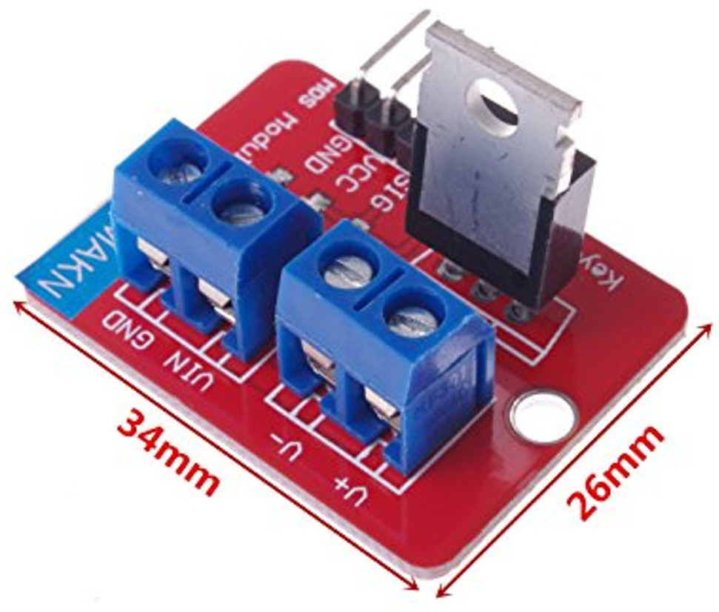
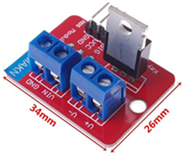
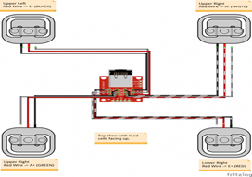
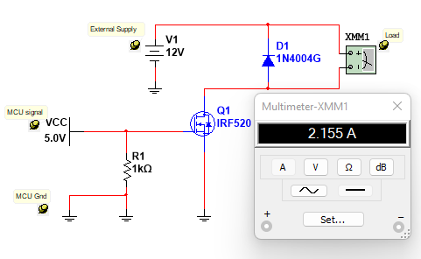
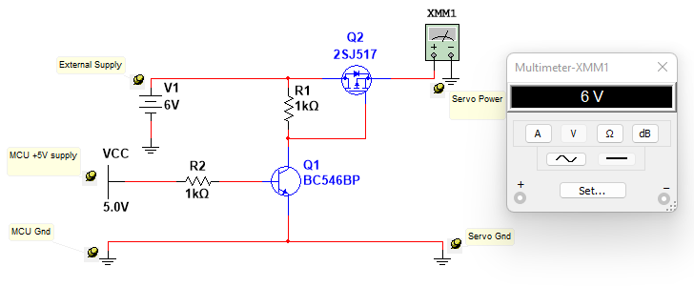
Methodology: Electrical
P16-S Micro-linear actuator
MG996R Servo motor
50Kg Strain-type load cells

Slide 14
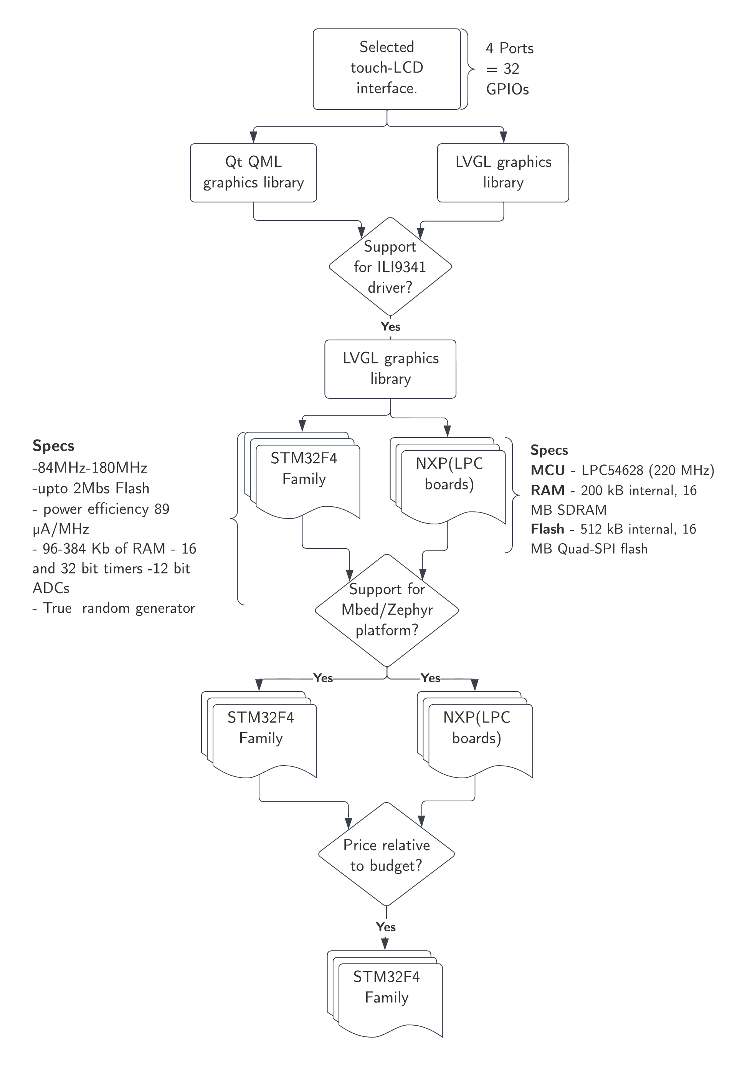
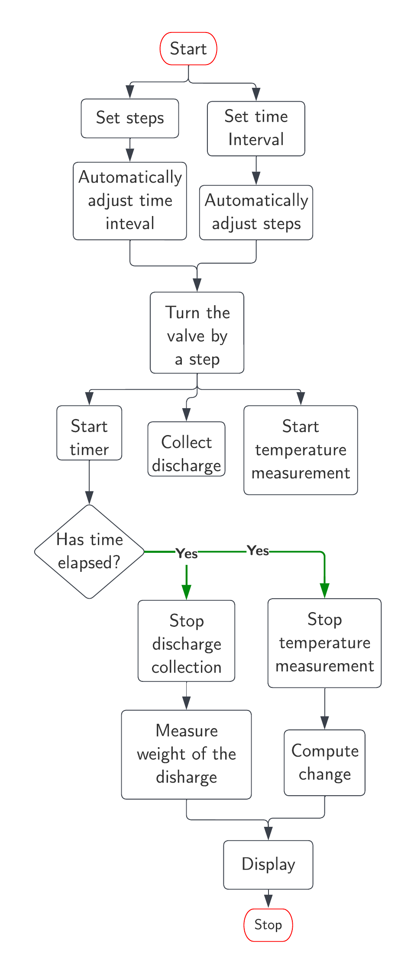
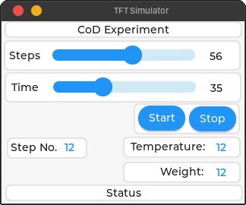
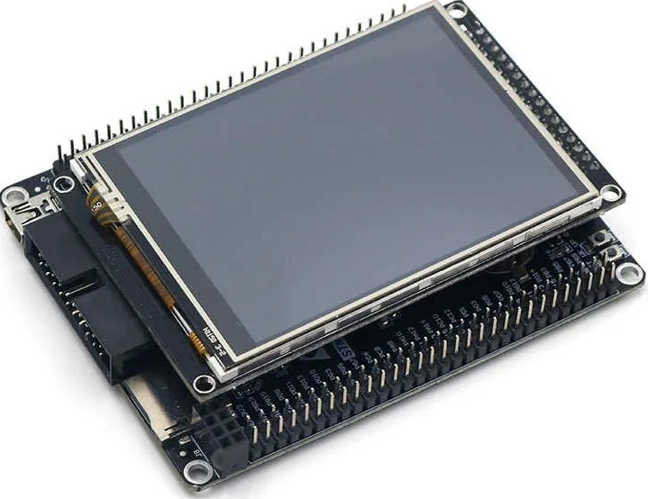
Methodology: Software and control
MCU Selection
Black_F407VE + Touch LCD
Application logic

Slide 15


